Slide 1
The Screwballs Sprint 3 Review
Chloe Brooke, Anna Buchele, Andrew Holmes, Paige Pfenninger
Notes:
Chloe

Slide 2
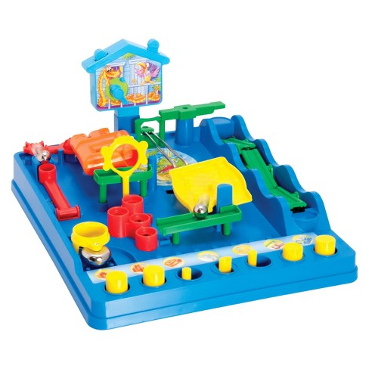
Review: Screwball Scramble
Objective: You and your teammate must work together to get the ball to the end of the obstacle course. Some of the obstacles will require the work of both teammates (e.g. one player passes the ball, another catches), and the game isn’t won unless both teammates get their ball through the obstacles.
Scoring: The game is scored based on how quickly the players can move their balls through the obstacles.
bit.ly/2pZAVsO
Notes:
Chloe

Slide 3
MVP Game Definition
Minimum Viable Game:
Two-player cooperative game; four obstacles per player.
MVG Feature Set:
Controls precisely actuating the motors which control the features of the game.
Biggest technical risk:
Precision. We need to reliably pass the ball between obstacles.
Notes:
Chloe

Slide 4
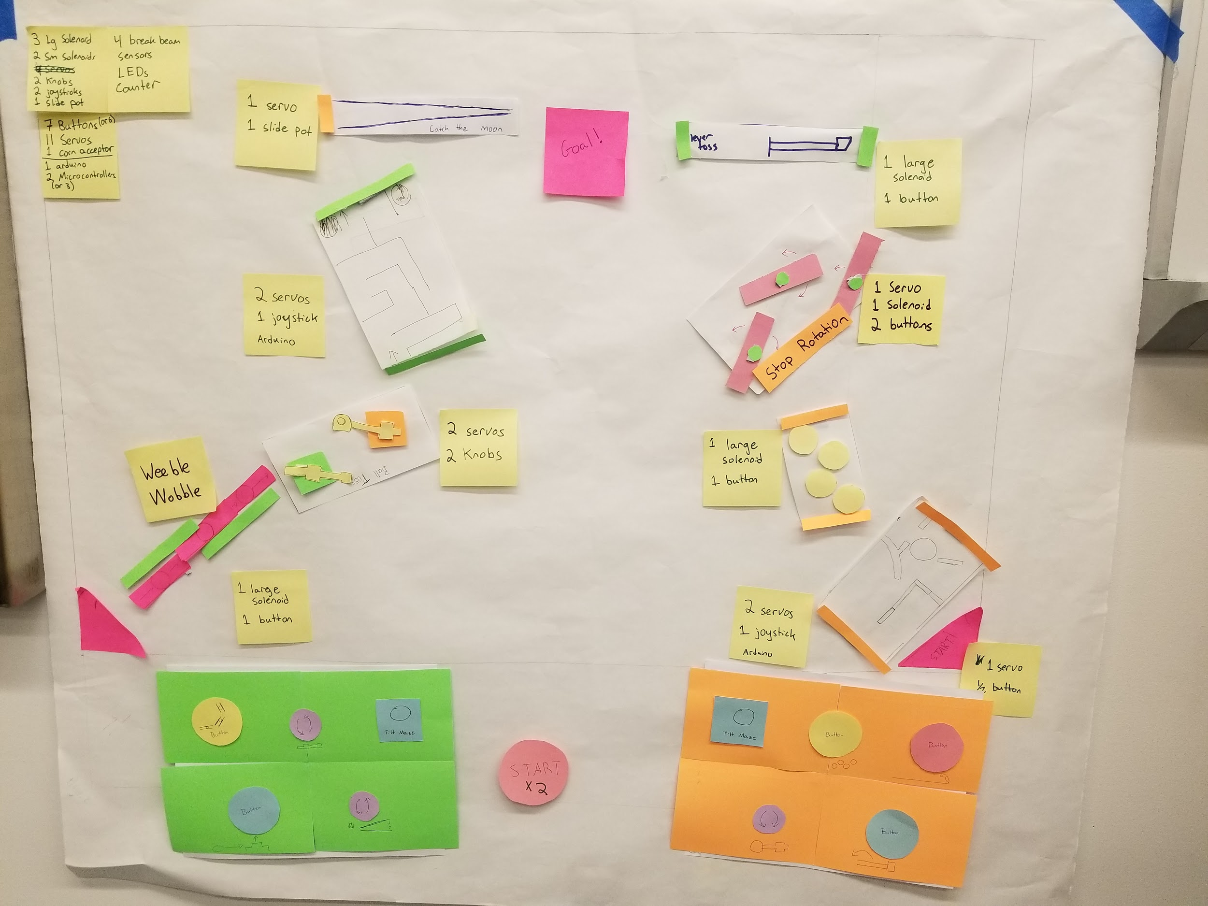
Notes:
Paige

Slide 5
Original Goal for this Sprint
MVP: Complete the base and mount and connect the three obstacles that we currently have build
Stretch: Complete start and end conditions and mount two more obstacles
Notes:
Andrew

Slide 6
Updated Goal for this Sprint
Design and manufacture all eight obstacles
Complete start and end conditions
Stretch: Get all eight obstacles working smoothly individually
Notes:
Andrew

Slide 7
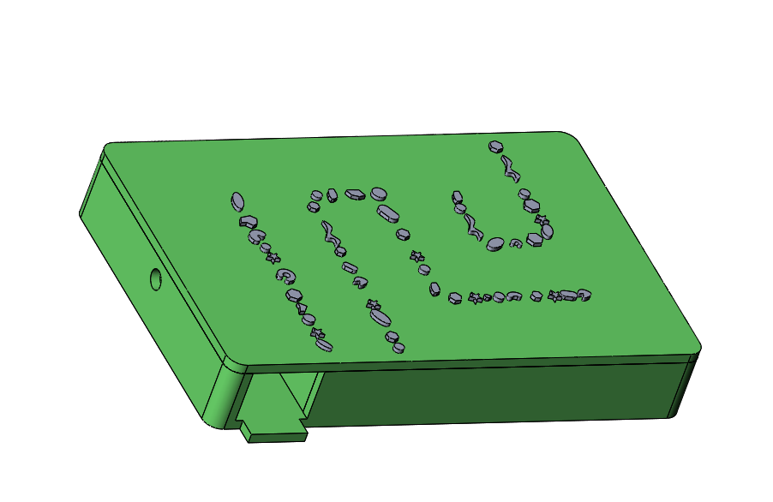
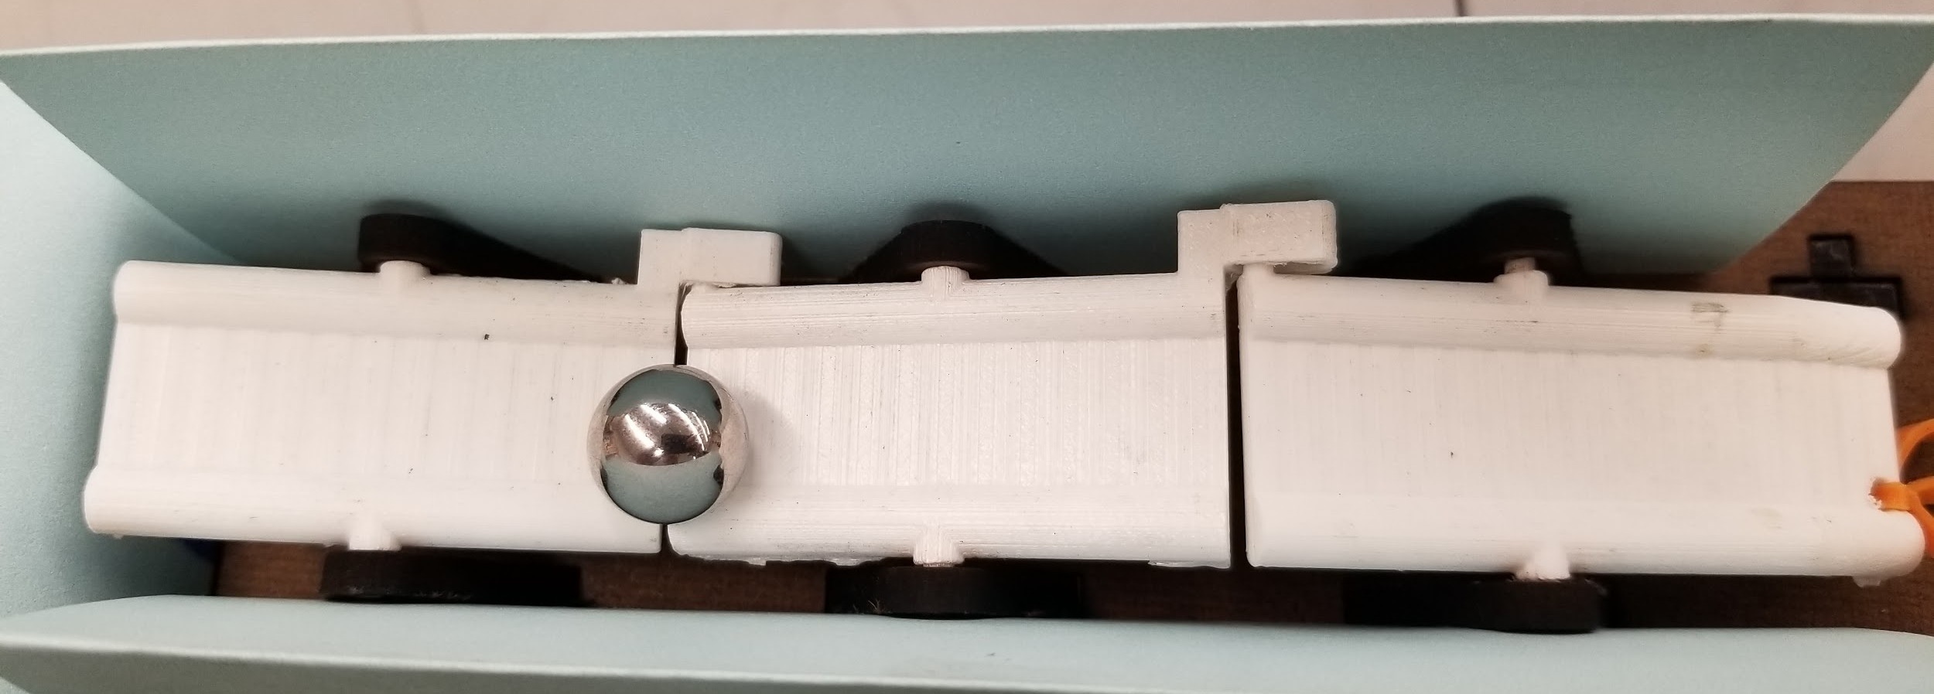
Player 1 Obstacles
Weeble Wobble
Covered Tilt Maze
Controlled using a button that actuates a solenoid
Controlled using a joystick that actuates two servos
Notes:
Andrew

Slide 8
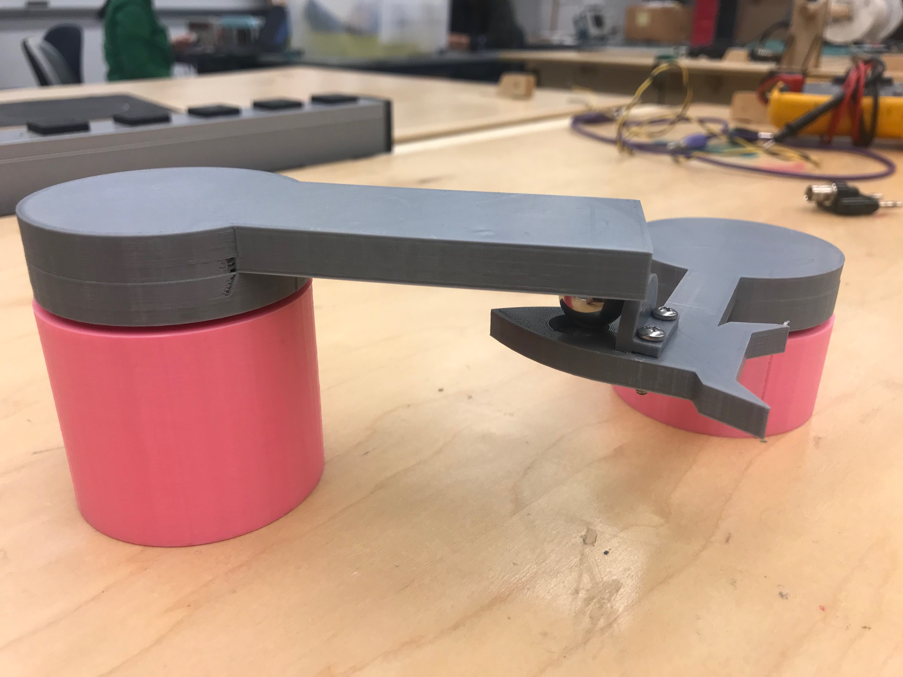
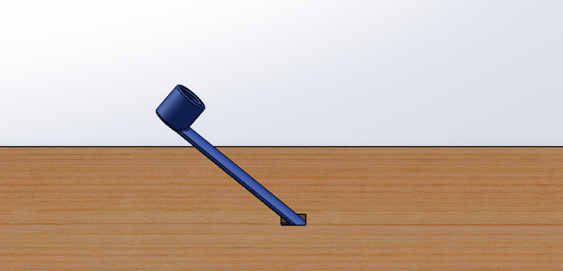
Player 1 Obstacles
Ball Pass
Lever Toss
Controlled using a button that actuates a solenoid
Controlled using two dials that actuates two servos
Notes:
Andrew

Slide 9
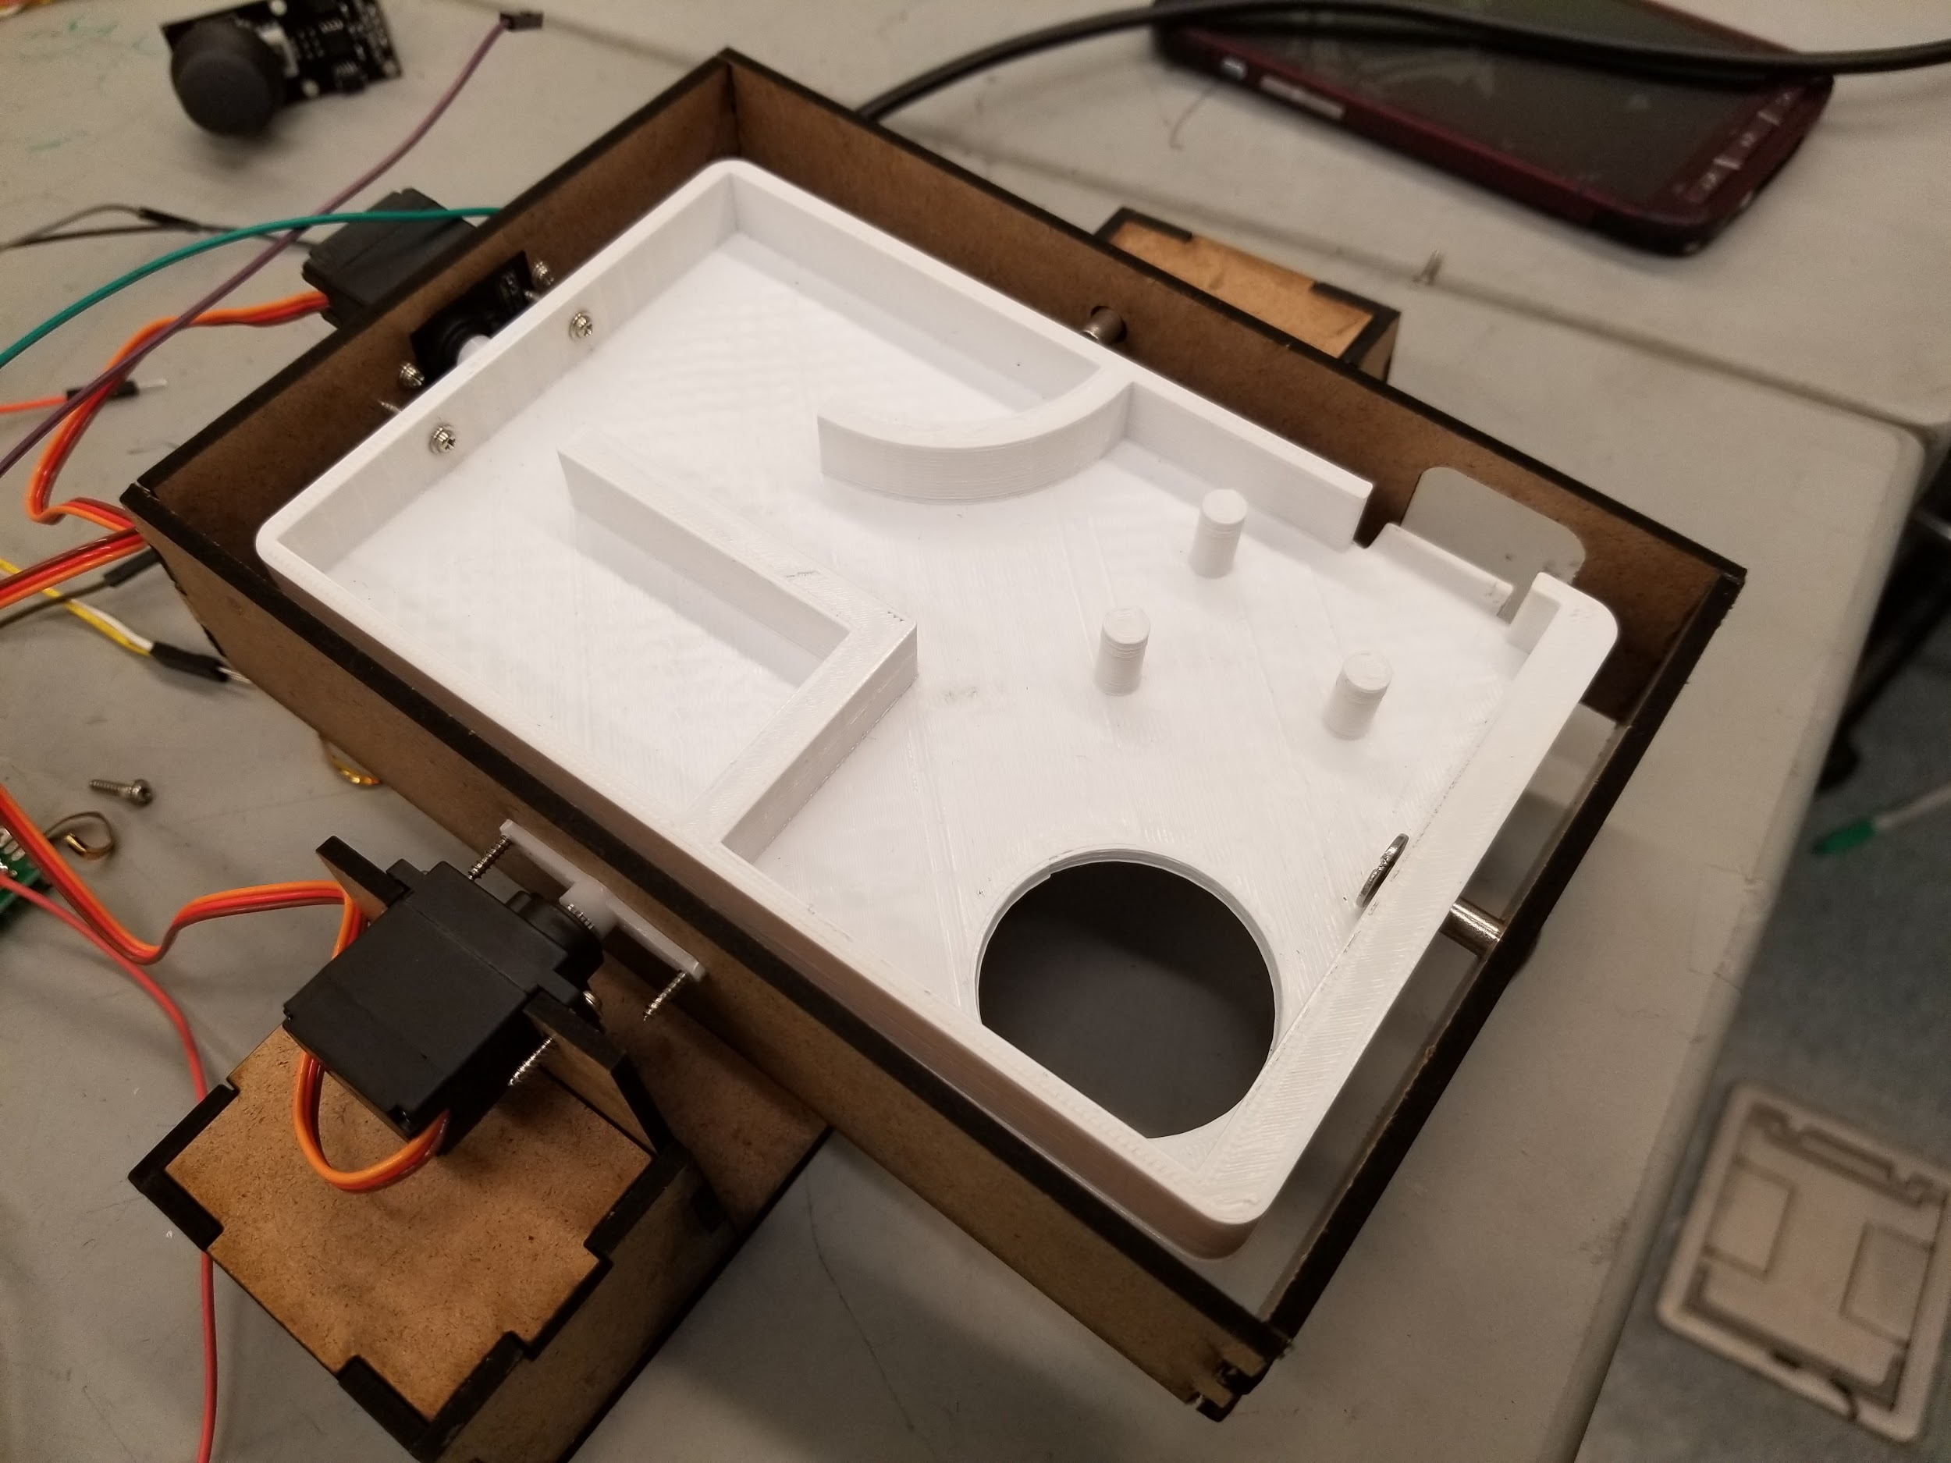
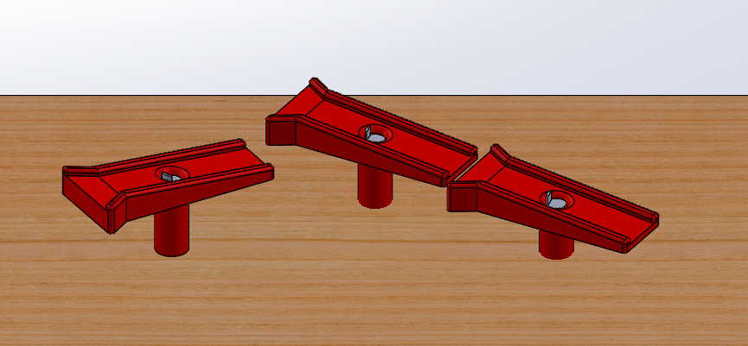
Player 2 Obstacles
Tilt Maze
Swishel Swashel
Controlled using a joystick that actuates two servos
Controlled using two buttons that actuate a servo and a solenoid
Notes:
Chloe

Slide 10
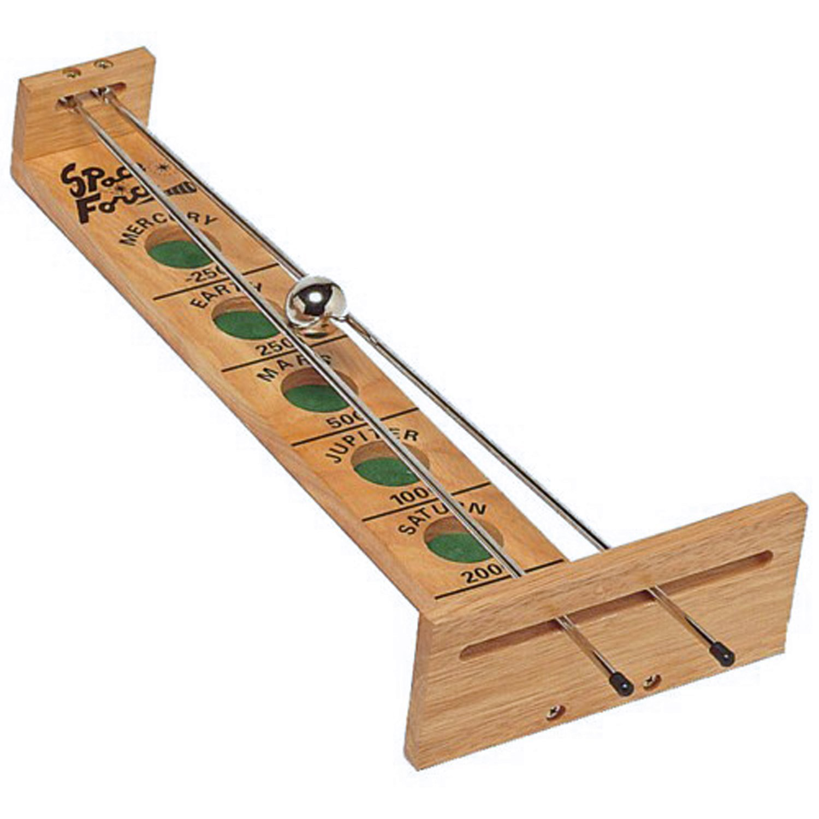
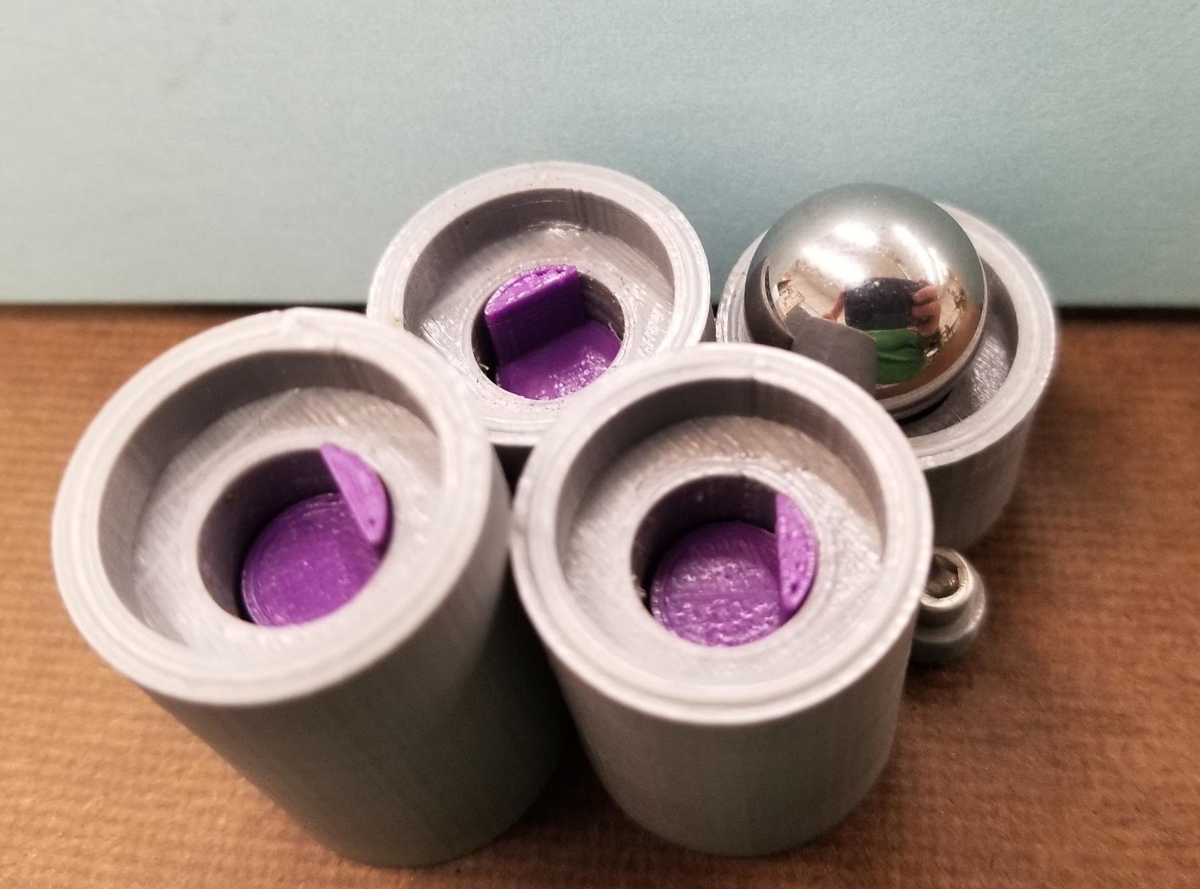
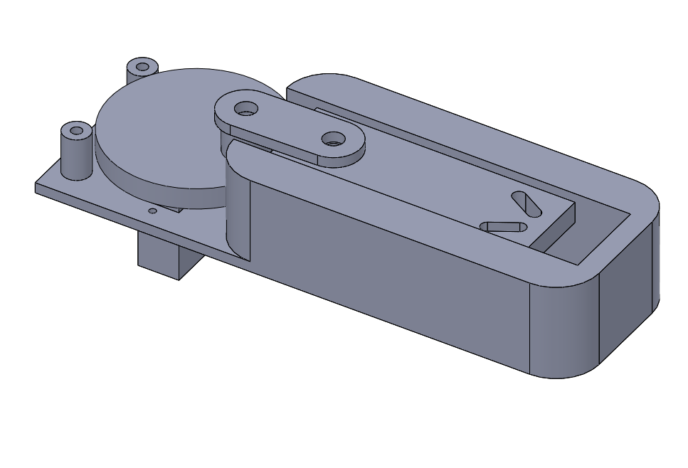
Player 2 Obstacles
Popper
Shoot the Moon
Controlled using a button that actuates a solenoid
Controlled using a slide pot that actuates a servo (work in progress)
Notes:
Chloe

Slide 11
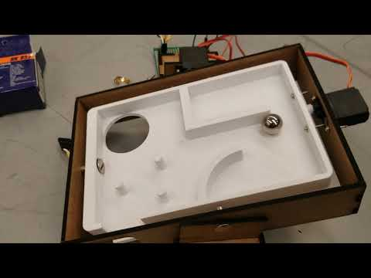
Tilt Maze
Notes:
Anna

Slide 12
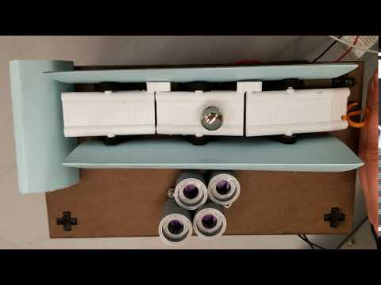
Weeble Wobble
Notes:
Paige

Slide 13
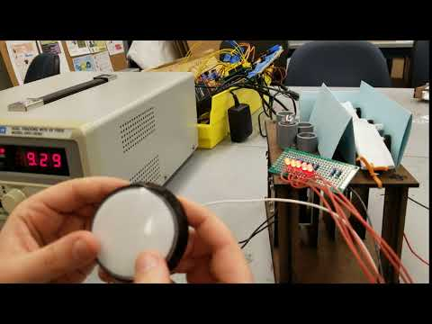
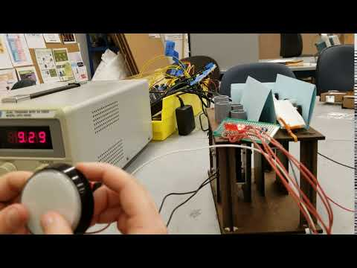
Popper
Notes:
Paige

Slide 14
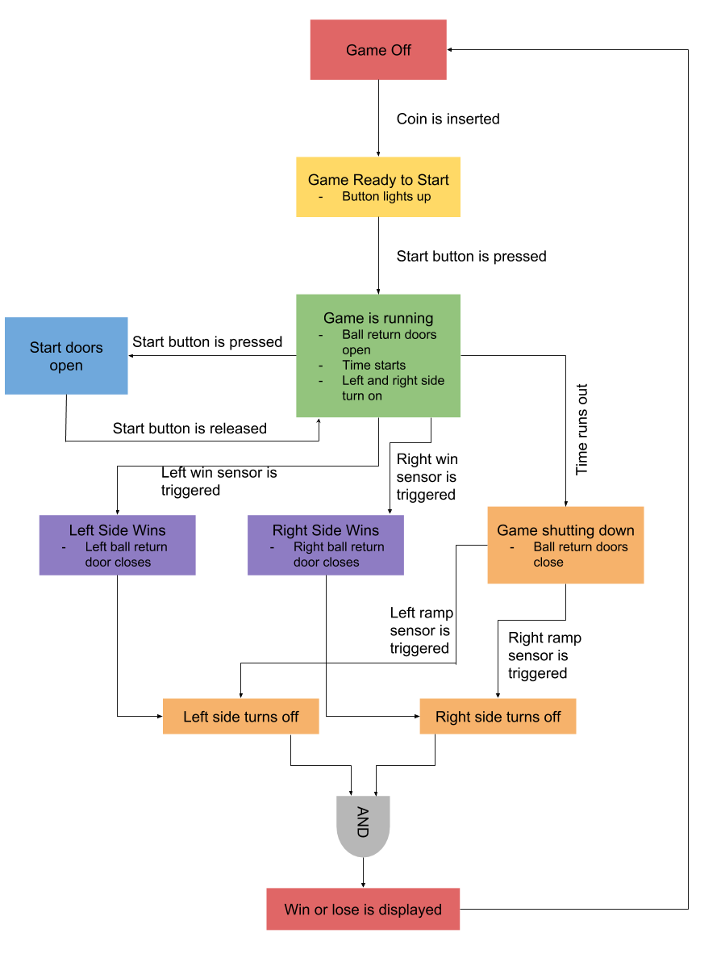
Start and End Conditions
Notes:
Paige

Slide 15
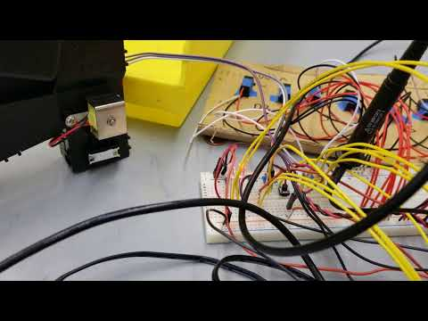
Start Stop Conditions
Notes:
Paige

Slide 16
Lessons Learned
Digital pins on the microcontroller can overwrite each other. When it happens, you will be sad.
Read the reviews when shopping online
When using Arduinos, death is inevitable
We might soon change our name to Screwed Ball Scramble
Notes:
Anna

Slide 17
Development Plan
Goals for next sprint:
Complete construction of the base
Mount obstacles to the playing field
Create static connections between obstacles
Finish code logic behind obstacles
Design and fabricate the control panels
Make the game space themed
Notes:
Anna

Slide 18
Development Plan
Biggest potential problems:
Securely attaching everything to the base while maintaining a usable ramp for the ball to slide down
Solution: design pillars around the attachment points to direct the ball downwards
Wire management
Solution: start using protoboards instead of bread boards. Make electrical system early
Notes:
Anna

Slide 19
Questions:
What two colors should our game be?
Do you think we are overlooking anything?
Notes:
Anna

